Slide 1

Dell TCP
Group F
Eileen Chen Noah Sung Jimmy Lee

Slide 2
Agenda
1
Excecutive Summary
2
PMIC
3
DRAM
4
ABF
5
Solutions

Slide 3
Excecutive Summary

Slide 4
Executive Summary
Market analysis
There are still DRAM demands but the suppliers didn’t plan to expand the capacity, so there might be chances that the components to be under constraint
As demand for ABF substrates continues to expand at a faster rate than predicted, the shortage is growing.
Short term solutions
Dell could agree to share increased cost with key suppliers to ensure capacity matches the demand for high-end products
Optimize production allocation and supply chain networks in accordance with the origin of components.
long term solutions
In the long term, we recommend looking for secondary source that best fit our product needs.
Strategies of enterprise must be established considering product life cycles of each product line and their alignment with the strategy of supply chain management.
Dell should build and maintain strong and positive business relationships with suppliers for striking stronger deals in the future

Slide 5
DRAM

Slide 6
Value Chain
DRAM
Format 1
design house & manufacturer
foundry
packaging
module manufacturer
PC manufacturer
Format 2 : major on third
design house & manufacturer
module manufacturer
packaging
module manufacturer
PC manufacturer
Format 3 : major on major
design house
& manufacturer
PC manufacturer
Source: INSIDE.com
Notes:
Simplified version

Slide 7
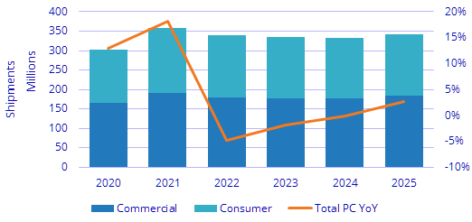
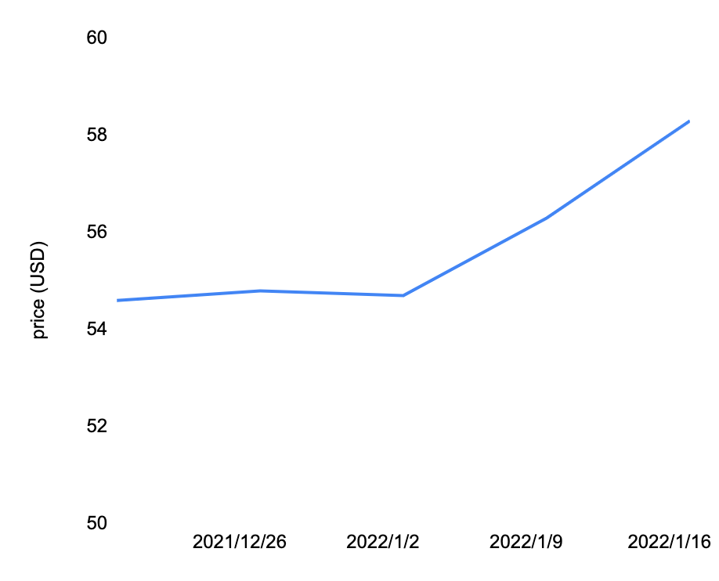
There are still DRAM demands but the suppliers didn’t plan to expand the capacity, so there might be chances that the components to be under constraint
DRAM
Demand side: There are still PC demands resulting from WFH and brand new high-level GPU and CPU published by intel and AMD. The expansion of cloud service also leads to the increase demands of servers and DRAM. Plus, the inventory level of DRAM is low now so companies are going to replenish the stocks.
Supply side: Supply is tight because the 3 mian DRAM manufacturers are not going to expand the capacity and the human capital is still under constraint due to COVD-19.
There are still PC demands from consumers
DRAM price surges as supply does not go up
Source: Commercial Times,
Notes:
YoY是負的 因為基期太高
為什麼不擴廠？？因為去年價格走低，減少資本支出
產能未有擴張打算＋疫情衝擊人力還沒有回補
以前價格有掉 現在又回來
CPU & GPU 跟dram關係？
https://ctee.com.tw/news/stocks/583469.html
下游庫存回補＋出新筆電＋WFH持續
由於2021年下半年DRAM價格走跌，包括三星、SK海力士、美光等三大廠都縮減資本支出，2022年投資重心鎖定在製程微縮，沒有大幅擴增產能計畫，因此業界推估2022年位元供給增幅將降至20％以下，

Slide 8
Dell might be suffer from the DRAM shortage
DRAM
test
Dell DRAM demands prediction
Dell purchases prediction
Source:

Slide 9
PMIC

Slide 10
ABF

Slide 11
Value Chain
ABF Substrate
Polyimide
Polyimide
Glass fiber
Glass fiber
Consumer electronics
Copper foil
Copper foil
Epoxy

Slide 12
As demand for ABF substrates continues to expand at a faster rate than predicted, the shortage is growing
Demand Side: Emerging technologies like big data, artificial intelligence, the Internet of Things, and automotive intelligence have fueled a surge in worldwide processing power demand, which has bolstered the HPC chip industry. The demand for ABF carrier boards has risen in tandem with the need for HPC chips.
Supply Side: The IC substrate industry has high entry barriers. Factors of material shortage and yield rate reduction have restricted capacity.
Demand rises fast for HPC chips
Capacity has been increasingly short of demand
100
100
100
100
100
Average monthly production capacity
Other
average monthly demand
( 100 million of units )
PC
Server/Data Center
GP
2019
2020
2021
2022
2023
2019
2020
2021
2022
2023
Source: Goldman Sachs, SinoPac
1

Slide 13
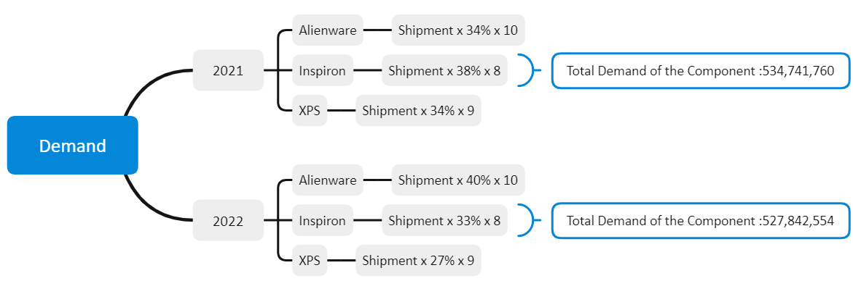
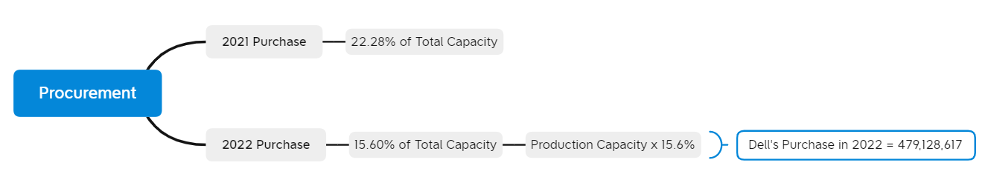
From our demand & purchases forecast for ABF substrate in 2022, there is a supply and demand gap
13

Slide 14
Solutions

Slide 15
Solutions
short term solutions
Dell could agree to share the increased costs with key suppliers to ensure capacity matches the demand for high-end products.
In the short term, we recommend optimizing production allocations and supply chain networks in accordance with the origin of the components.
long term solutions
In the long term, we recommend diversifying supplier networks and looking for a secondary source that best fits our product needs.
Strategies of procurement could be established considering the product life cycles of each product line (XPS/Inspiron/Alienware) and their alignment with the strategy of supply chain management.
Dell should maintain strong and positive business relationships with suppliers for striking stronger deals in the future.

Slide 16
Thanks for listening

Slide 17
Appendix

Slide 18
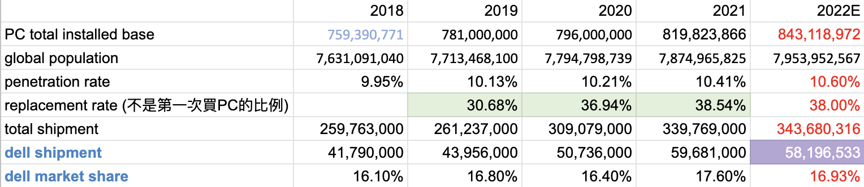
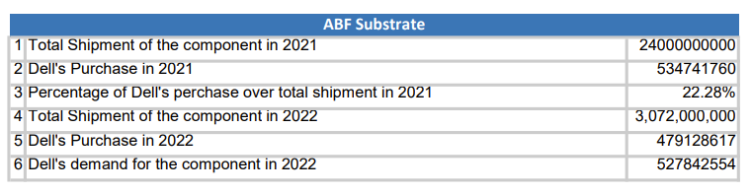
Dell PC demand calculation

